Slide 1
Integration Proposal
Allowing Equity customers to take an ecomoto loan for a KOKO cooker

Slide 2
Ecomoto loans context
Equity Bank provide micro-financed loans to their customers for clean energy products.
KOKO Networks would partner with Equity to become a product eligible for a loan, reducing the upfront cost for potential KOKO customers who may not have that cash available.
In order to do this we need to be able to receive loan amounts and disburse them against individual customer accounts, so that our normal order creation and fulfilment processes could be followed.

Slide 3
High level customer journey
Equity customer decides to buy a KOKO Cooker
Using the documentation sent by Equity, we have furthered our thinking around how we can enable the Ecomoto loan product for KOKO customers.
Customer is signed up on myKOKO by Equity Agent
Customer opens Equity USSD
Customer navigates through the ecomoto steps
Loan granted to customer by Equity
Proposed Technical Integration in Slide 10
Funds sent to KOKO’s Equity account
Funds distributed to customer’s KOKO account
Order is paid -
customer can collect Cooker

Slide 4
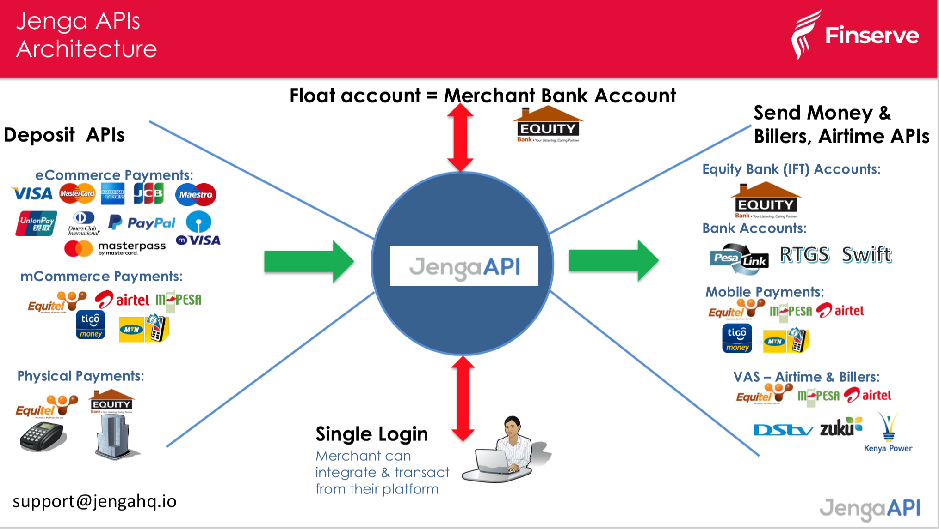
Is the Account Alerts callback notification the best way to inform KOKO systems about an Equity Customer loan disbursement?
reference:
https://developer.jengaapi.io/docs/callbacks
If so, can you provide an example of an eco moto loan disbursement notification (all alert callback API fields populated with the data we would receive)
Will we receive loan disbursement as a deposit in our Merchant Bank Account ?
Is Eazzy Pay the m-commerce solution for loan disbursements and customer payments?

Slide 5
Integration Proposal
Looking at the documentation we think it is possible to leverage the Jenga API to receive funds and distribute to individual accounts (see diagram on previous page). Is this integration feasible?
Technical Questions
Please confirm which API is used to notify us of incoming loan disbursements for customers (see previous slide)?
Please confirm information would be passed in the API body for a loan disbursement?
What are the prerequisites to get started with this solution? Assuming an equitel mobile money account? Any technical / security requirements? Looking at the Jenga documentation, it appears to be fairly simple to set up a Jenga HQ account but is there anything else we should be aware of?
Commercial Questions
How is money sent to our Equity Bank account for a loan disbursement - Eazzy Pay?
If we have an Eazzy Pay Till is it already mapped to the same merchant account so that customer payments can also come through the same channel?
Is it free for a customer to send money to an Eazzy Pay till? Is it free for KOKO to receive the customer’s money or are there charges?
What is the percentage of partial loans to total loans disbursed via Eco Moto?
General Questions
Is it possible to have a centralized collaboration platform (google sheets, google slides) for easy, nimble, and real time collaboration?
What is the process for getting set up on the Eco Moto Platform?
Who is the tech contact person?

Slide 6
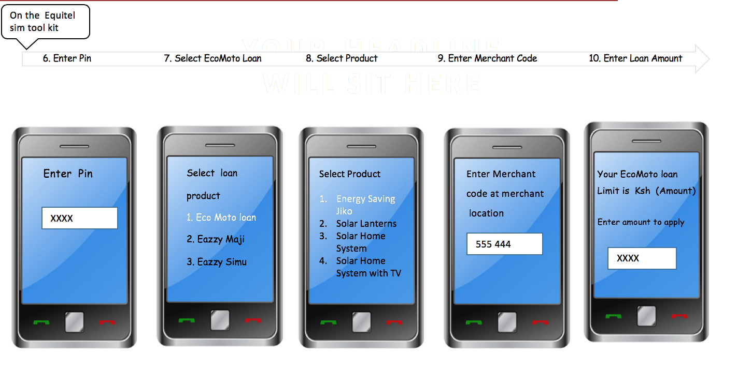
Ecomoto USSD Question
How does KOKO get added as a product on the Ecomoto product list and USSD?

Slide 7
User stories
As an Equity customer I want to apply for a eco moto loan so that I can buy a KOKO Cooker.
As an Equity customer I want my loan amount to be sent to KOKO Networks so that it can be added to my balance as payment for my KOKO Cooker.
As KOKO Networks I want to be able to know which Equity customer I have received money based on phone number so the amount can be added to their account.
As an Equitel user who has purchased a KOKO Cooker I want to be able to send money from an MPESA number so that I can buy additional KOKO products.

Slide 8
Dev Tasks
Validate which of the Jenga APIs can be used for distributing funds from Equity to our merchant bank account
Connect our bank account to KOKO Core using the Jenga API
Simulate a loan transaction (both on sandbox and with live environment)
Introduction of an Equity line on KOKO Core - see here
Log and investigate all API failures; design responses / workarounds

Slide 9
Non functionals + deployment
Performance
We would not expect to receive more than 100 loans per day. However the system must be able handle multiple requests concurrently, or queue them, and not impact any of the other incoming payment transactions in KOKO Core. This should be considered as part of testing.
Security
Does this API include any vulnerabilities for us?
Ensure adequate password protection for the Equity Bank account portal and jenga API
Deployment
Would require a KC release.
We should attempt some real money transactions on stage before pushing this to prod?

Slide 10
Alice Morton | a.morton@kokonetworks.com

